Slide 1
Introduction to Javascript

Slide 2
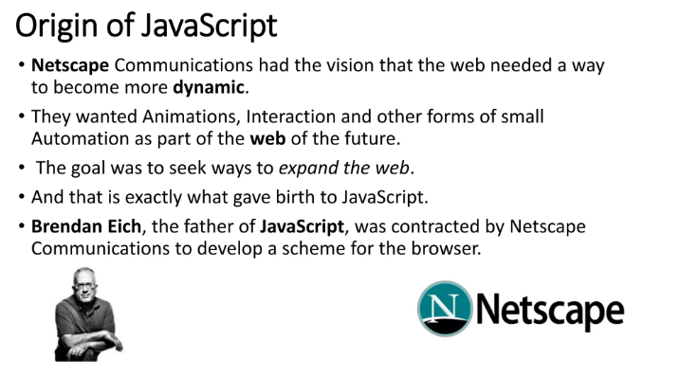

Slide 3
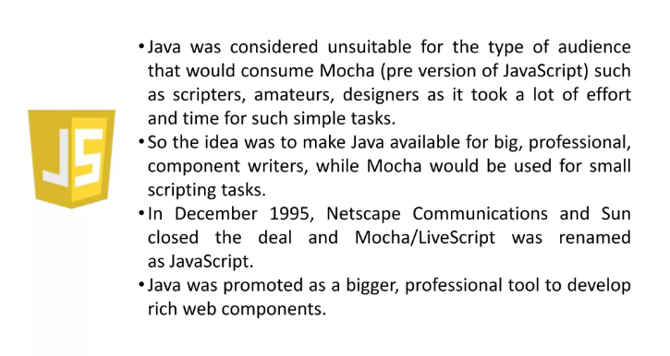

Slide 4
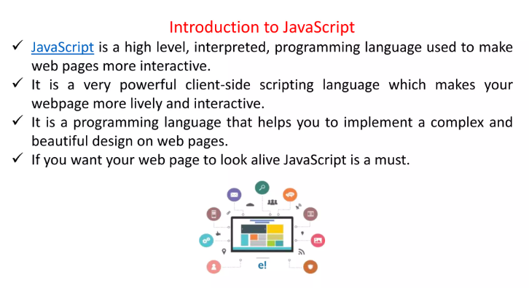

Slide 5
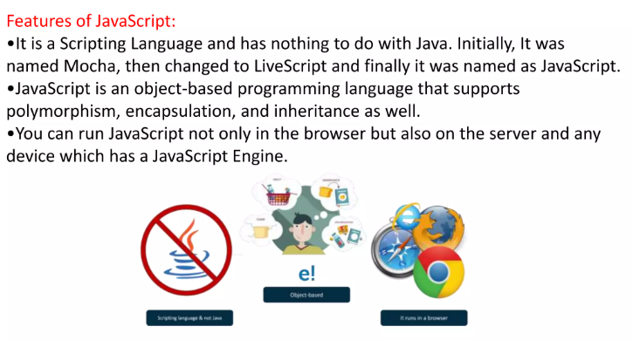

Slide 6
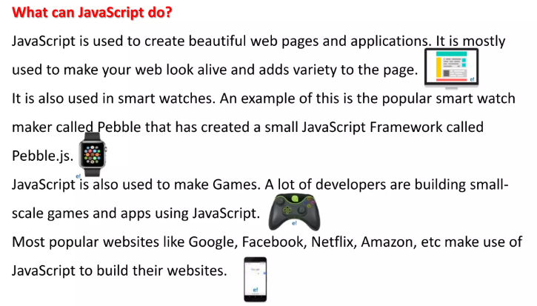

Slide 7
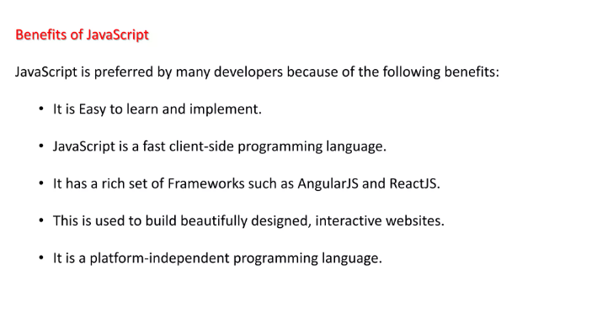

Slide 8
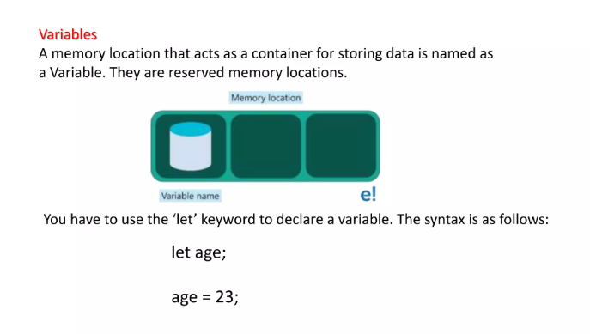

Slide 9
Variables are Containers for Storing Data
JavaScript Variables can be declared in 4 ways:
Automatically
Using var
Using let
Using const

Slide 10
When to Use var, let, or const?
1. Always declare variables
2. Always use const if the value should not be changed
3. Always use const if the type should not be changed (Arrays and Objects)
4. Only use let if you can't use const
5. Only use var if you MUST support old browsers.

Slide 11
JavaScript Identifiers
All JavaScript variables must be identified with unique names.
These unique names are called identifiers.
Identifiers can be short names (like x and y) or more descriptive names (age, sum, totalVolume).
The general rules for constructing names for variables (unique identifiers) are:
Names can contain letters, digits, underscores, and dollar signs.
Names must begin with a letter.
Names can also begin with $ and _ (but we will not use it in this tutorial).
Names are case sensitive (y and Y are different variables).
Reserved words (like JavaScript keywords) cannot be used as names.

Slide 12
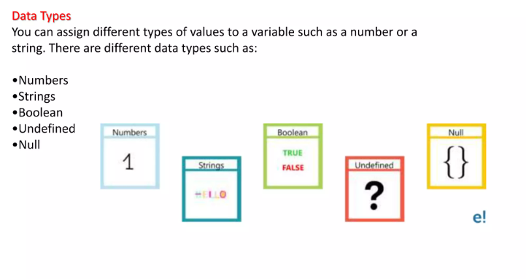

Slide 13
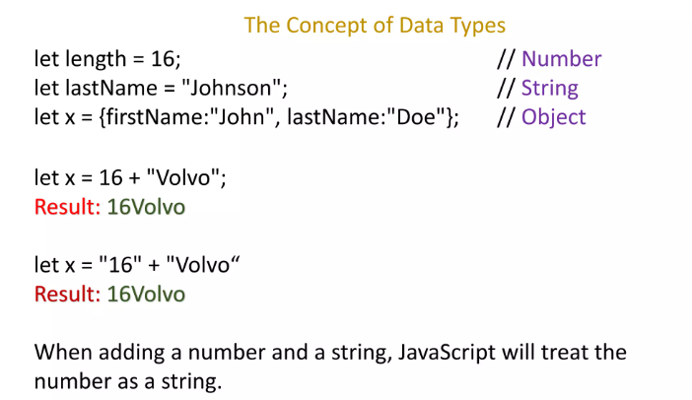

Slide 14
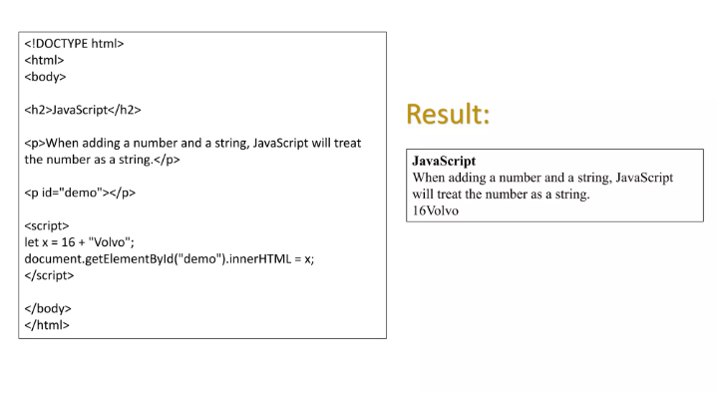

Slide 15
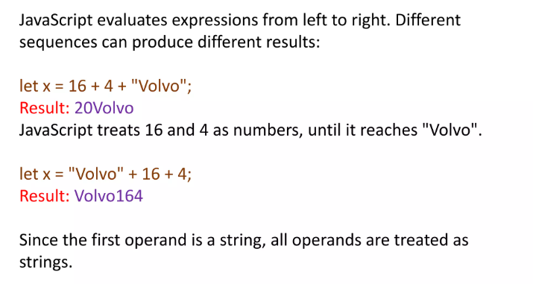

Slide 16
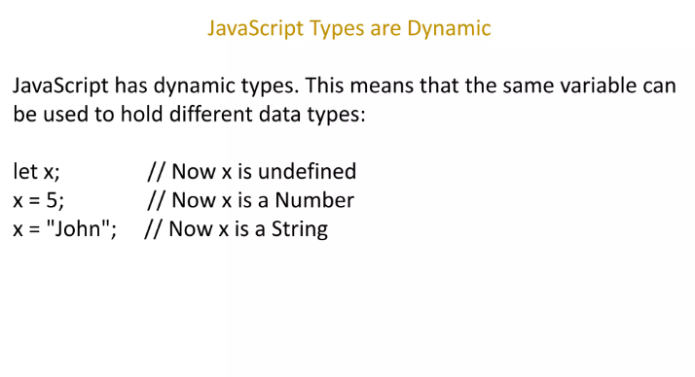

Slide 17
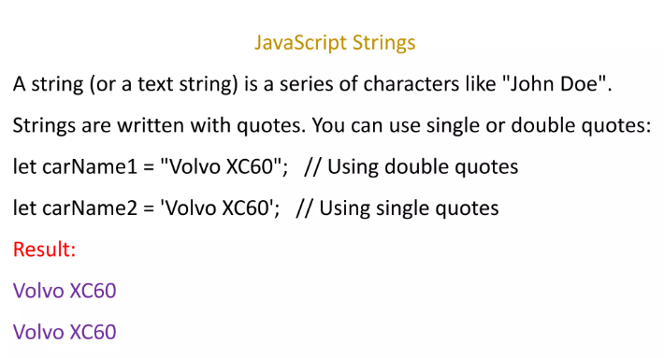

Slide 18
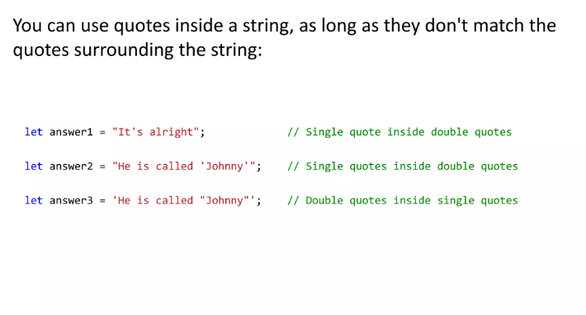

Slide 19
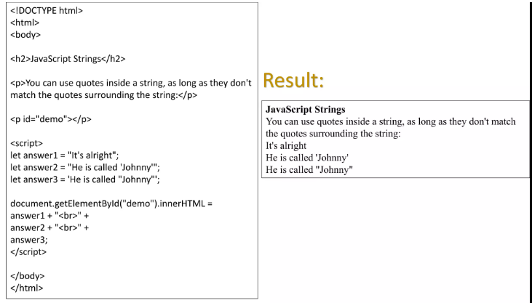

Slide 20
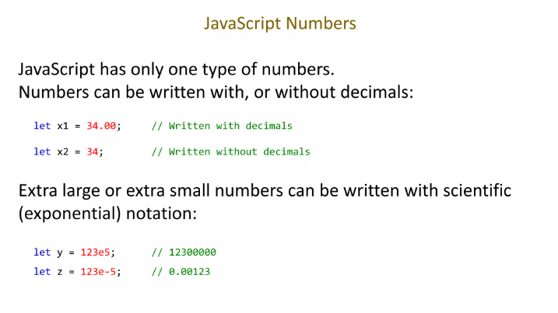

Slide 21
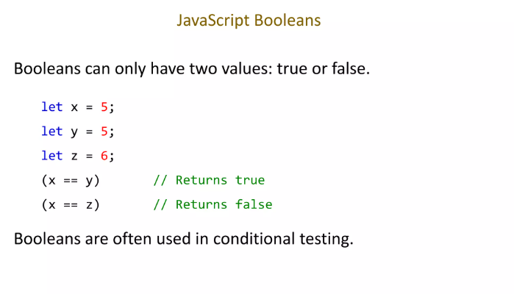

Slide 22
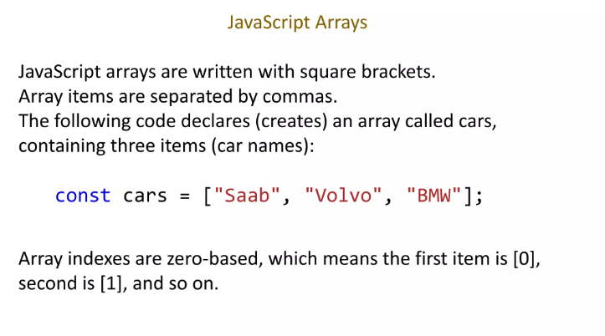

Slide 23
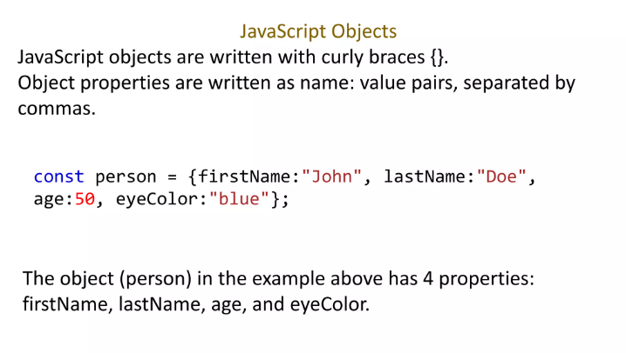

Slide 24
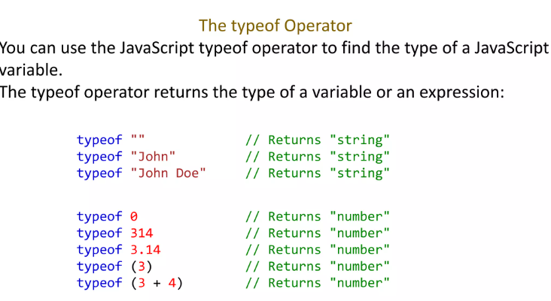

Slide 25
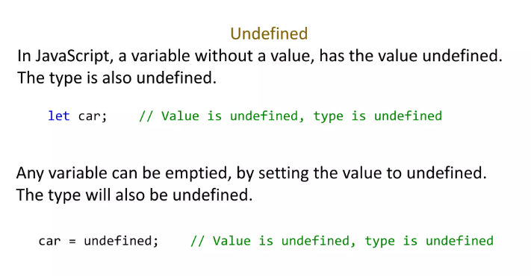

Slide 26
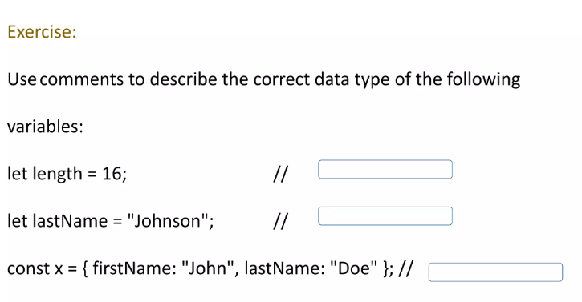

Slide 27
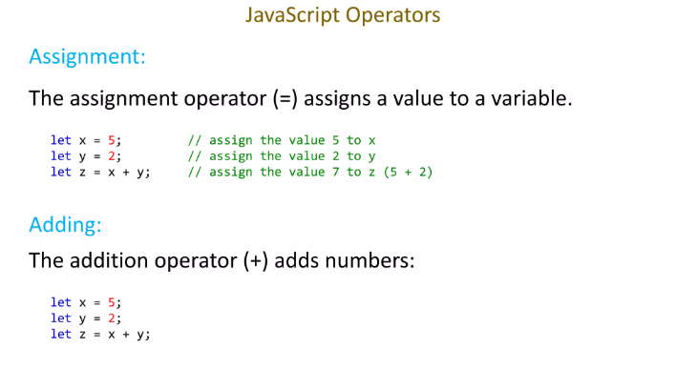

Slide 28
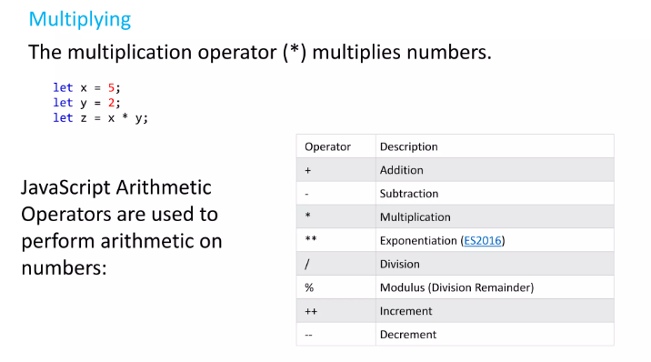

Slide 29
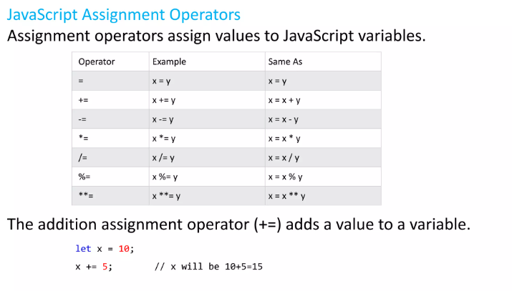

Slide 30
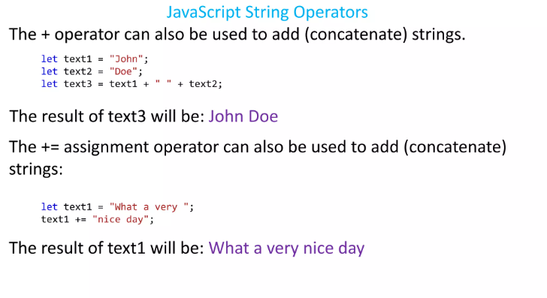

Slide 31
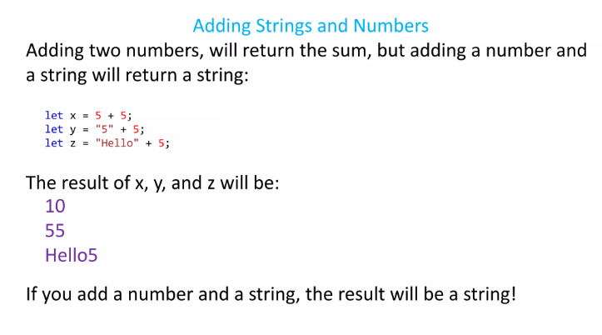

Slide 32
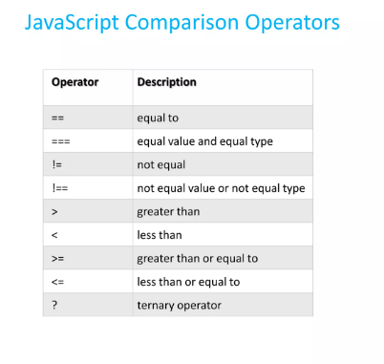

Slide 33
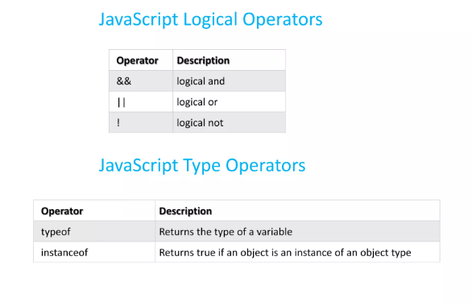

Slide 34
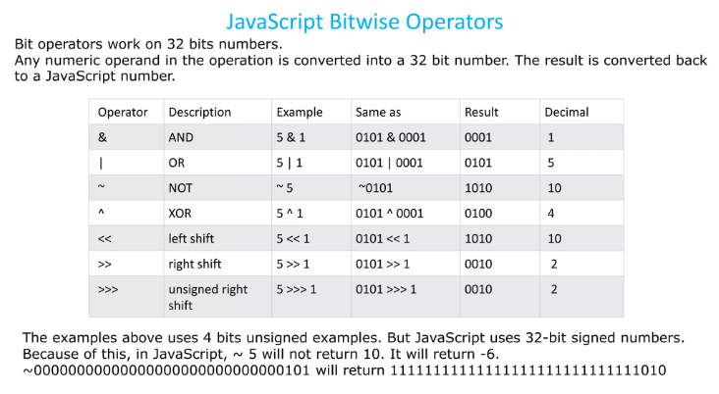

Slide 35
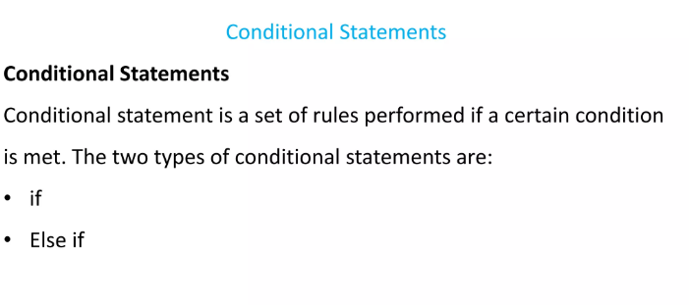

Slide 36
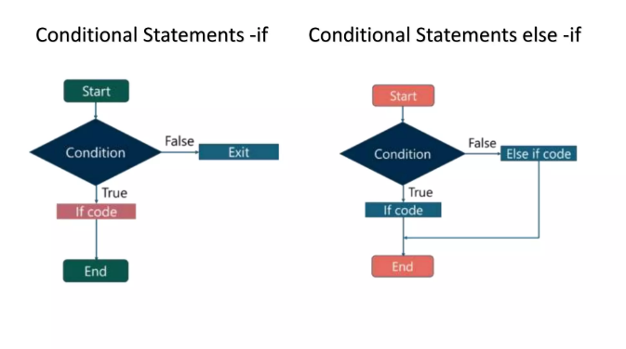

Slide 37
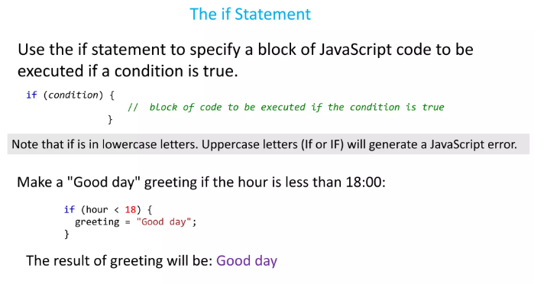

Slide 38
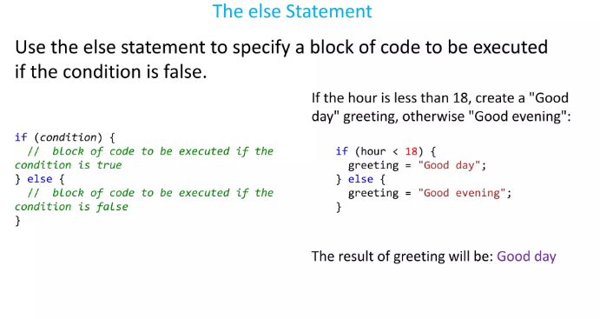

Slide 39
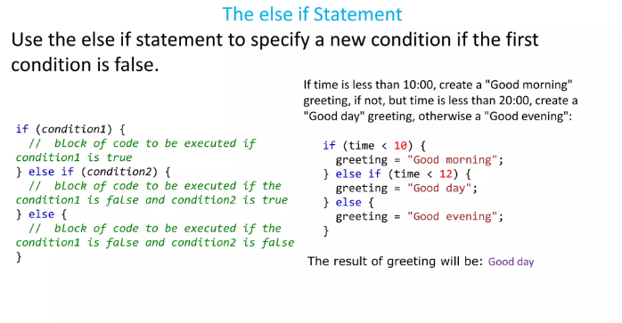

Slide 40
